Slide 1
Visible Light ID System
Utilizing free space optics for indoor real-time locating and tracking
Earl Co
Professor Michael Knox
NYU-Poly Wireless Communications Lab
April 22, 2013

Slide 2
Background Information
Free-space optical communication (FSO)
  “free space” – air, outer space, etc. medium in which light can propagate freely
  Can utilize light to encode and transmit information
    Network computers
    Telecommunications
Current uses:
  Infrared remote controls (low data rate)
  CD, DVD, Blu-ray drives
  Communication between spacecraft
  Smart lighting
Notes:
In today’s modern and highly technological age, many methods exist that
allow people and computer infrastructures to communicate
- Our cities + homes connected through copper cables and fiber optics
-RF waves from satellites, cell phone, wifi
Such technologies allow for high-bandwidth, high frequency, and long-distance transmission of data
Fully developed only within the last several decades
Wifi gaining mainstream consumer use in last 10 years
Among these radio and physical connections is
- Another current development in communication technology known as FSO
This Optical communication technology takes advantage of “free space” to transmit data
FSO can utilize light to transmit information from one point to another
Network computers or for telecommunications
When direct line-of-sight can be maintained
Today, we can recognize common uses of optical communication
Consumer infrared technology in remote controls which operates the same way except invisible IR
Use of lasers in media drives to encode and read data
Spacecraft communication
- with continued development in LED technology, light-emitting diodes will soon be powerful yet cheap enough to replace conventional incandescent and fluorescent light bulbs
Paving the way for “Smart lighting,” in which information is ubiquitously embedded into sources of light
such as room light fixtures, lamps
traffic signs
vehicle headlights and taillights.
These can then communicate with devices
Such as smartphones, computers,
And other vehicles

Slide 3
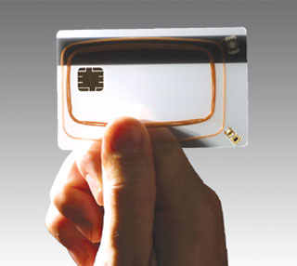
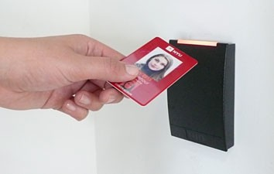
Background Information
Radio Frequency Identification (RFID)
  Utilizes electromagnetic induction to send and receive encoded data
  Common Configurations:
    Active Reader Passive Tag
    Passive Reader Active Tag
    Active Reader Active Tag
Current uses:
  Access control (people, cars, etc.)
  Identification (driver’s license, passport)
  Inventory (loss prevention)
  Product tracking (casino chips)
Notes:
RFID, or radio frequency identification, uses electromagnetic induction to transmit encoded information wirelessly to a reader.
Active transmitters and receivers require electricity, passive ones do not, and instead draw their power wirelessly using the radio energy transmitted by the reader as its energy source
Three common configurations exist for RFID systems:
Active Reader Passive Tag is the one we may be most familiar with. Inexpensive passive circuitry are embedded in objects and emit an encoded signal when brought near a reader.
Passive Reader Active Tag systems use battery-powered tags to periodically beam out its signal to activate nearby readers.
In Active Reader Active Tag systems, the reader wakes up the active tag with a signal, and in turn the tag begins sending its information.

Slide 4
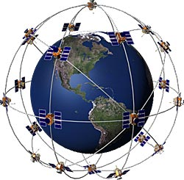
Application
Problem:
Indoor geolocation lacks accuracy
  GPS – requires line of sight (LOS) with the sky
  Wi-Fi – requires base station repeaters in almost every room (very expensive), diminishes over distance
  Cellular – Not precise enough, not interoperable between networks
  Signals are blocked by walls and other obstructions
Notes:
Geolocation and object tracking is imprecise indoors due to the lack of view of the sky. Companies exist that can install a system for indoor geolocation by way of WiFi triangulation, however the system is very expensive and requires Wi-Fi base station repeaters in almost every room, and still cannot be entirely accurate.

Slide 5
Project Objective
Indoor real-time locating system (RTLS) using existing lighting infrastructure
  Embed unique identification data in the light
  Receivers detect the high frequency invisible modulation in the light
  Collect location information based on where the LED bulb/lamp was installed
Work in tandem with GPS and Wi-Fi triangulation in supporting devices (smartphones)
Accuracy down to within 1-3 square meters
Notes:
A solution would be to design a system of transmitters and receivers that are able to detect unique signals from the existing lighting infrastructure and use that to collect information and map an object inside a building. These location receivers can be attached to devices and high-value items that are often misplaced such as medical carts in a hospital, and can also be used to track the location of personnel for security and safety. An ideal solution would be able to locate an object or person down to one square foot inside a building.
By leveraging free space optical communication technologies and existing lighting infrastructure in tandem with WiFi and A-GPS triangulation, WiFi-enabled optical receivers can detect its location by matching a signal to a database and broadcasting it to an internal network, tracking the receiver's location anywhere in the building.
(Navizon, Trimble TIMMS Indoor mapping)

Slide 6
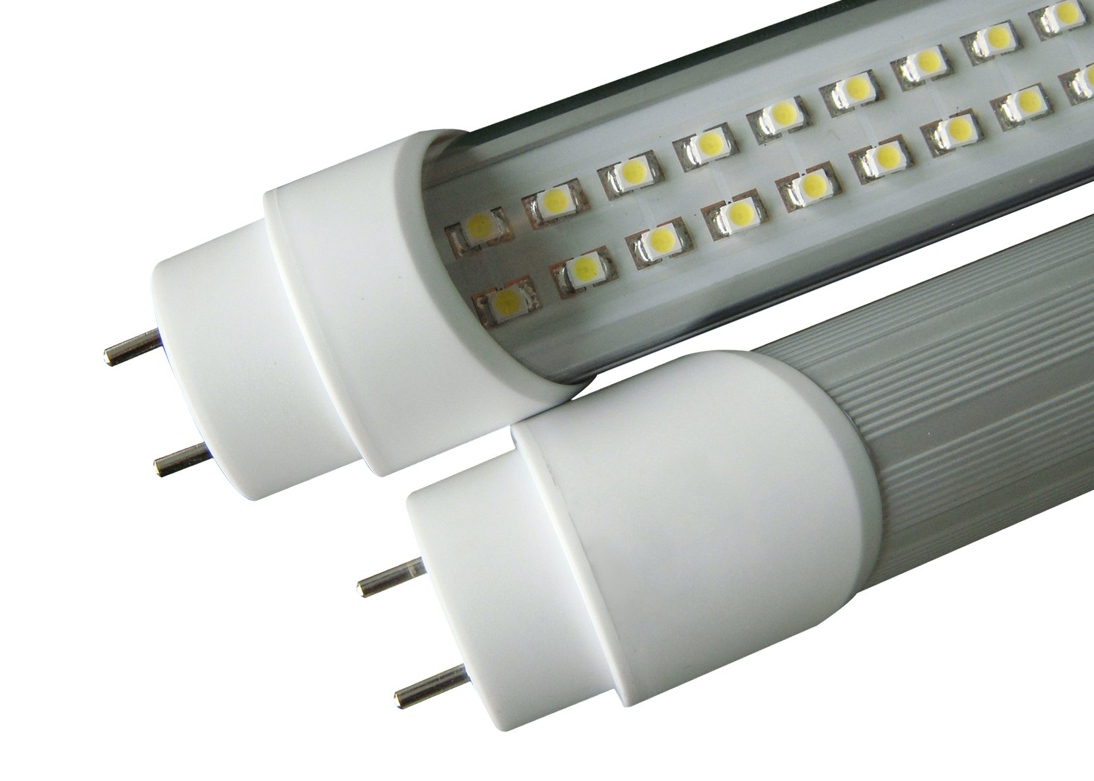
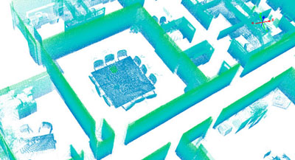
Technical Project Description
Backwards compatible with existing fluorescent, incandescent, and LED light fixtures
Unique serial code for every light bulb
Possibility for two-way communication – lights detect receiver tag signals and send it back to server for real-time tracking of objects
Possibility for mesh networks of lights communicating with each other

Slide 7
Summary
Proposed a system for indoor RTLS using the visible light spectrum and existing infrastructure
Plan to prototype and develop transmitter and receiver systems
Embed unique serial identification codes in individual LED light bulbs and tubes
Use inexpensive components to mass produce light modulation for widespread adoption

